Slide 1
Enterprise Architecture Critical Partner
Guidance
Notes:
Welcome to the first EA Critical Partner training

Slide 2
AGENDA & Objectives
The Role & Tools of the EA Critical Partner
Where Does the IT Strategy comes from?
Core Design Principles & Reference Architectures
What is the Role of EA CPs
EA CP Manual’s Guidance – high level review
EA CP Key probing questions, objective evaluation guidance - by phase with examples
Q&A

Slide 3

The Role of the EA CP is…
To ensure that the organization’s IT strategy and architecture vision is embodied into solution architecture’s designs and IT projects.
Ensure that architects and developers within project teams understand the organization’s IT strategy including core design principles, shared services, data sharing strategy, and other existing common IT assets;
Minimize redundancy and silos by promoting cross-organizational solutions;
Ensure new solution architectures are well documented (ConOps, Data Flows, Information Exchanges, component architecture, etc);
Provide technical expertise and organizational knowledge to architects and developers to guide new product designs and/or solution architectures.

Slide 4



Where Does IT Strategy Comes From?
HHS IT Strategy
CDC IT Strategy
Federal IT Strategy
C/I/O IT Strategy
Cloud First
Share First
Open Data
Modular Approach
Data APIs
Shared Services
Minimize Redundancies
IT Strategy
Notes:
Architecture = Design
Design = Strategy
Strategy = Planning
Enterprise perspective looking across project and organization silos eliminates rework
Agility through improved interoperability & reuse

Slide 5

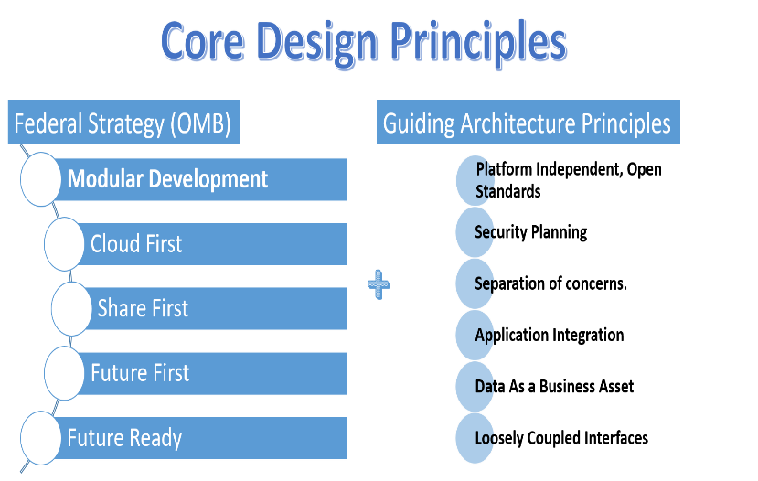
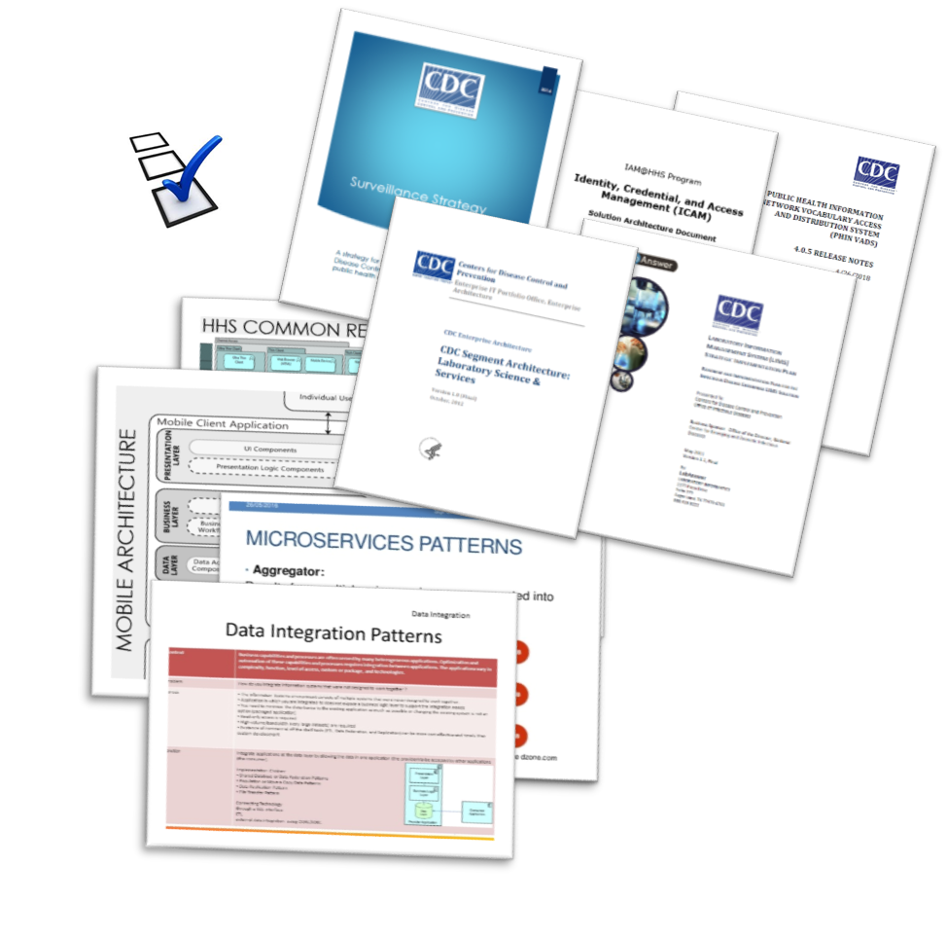
IT Strategy As Design Principles and Reference Architectures

Slide 6
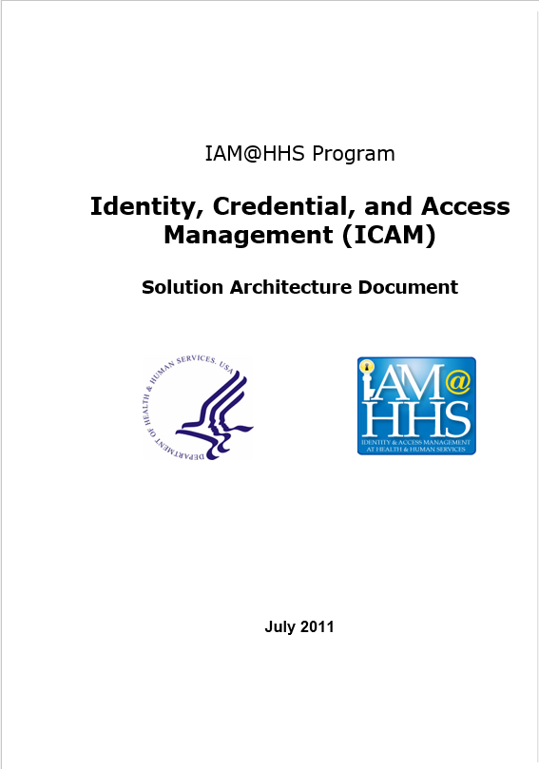



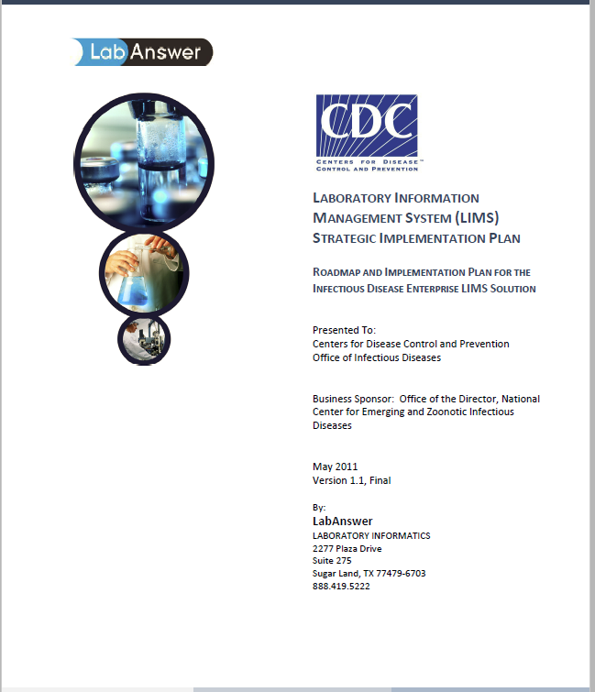
Reference Architectures (RA) - Examples
Notes:
Best practices, generalized solution that can used to select the solution capabilities, interactions, procedures to improve project success.
Accelerates the realization of goals and re-use of effective solutions through incorporating industry best practices.
Common taxonomy for technology selection and technology components re-use
Technology speak, but still a useful communication tool

Slide 7

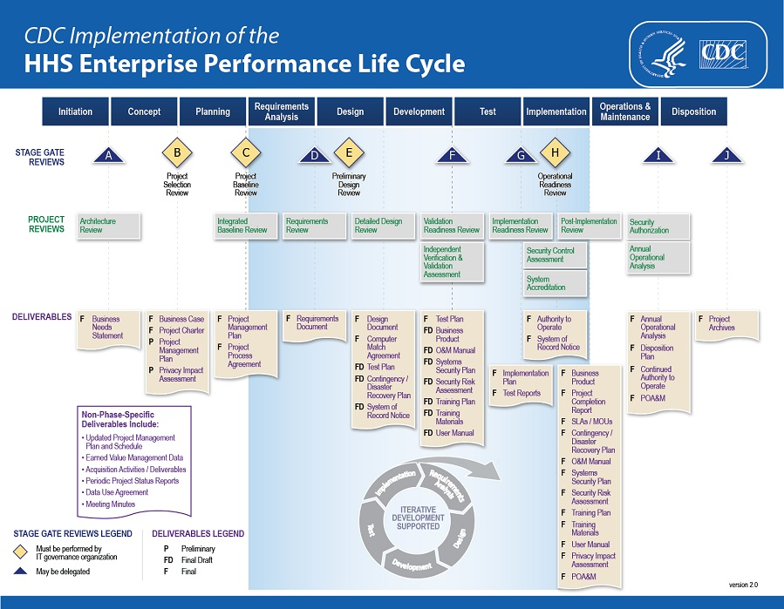

Performing the EA CP Role
It focuses on promoting the existing IT strategies to improve business outcomes.
Communicate IT Strategy, References Architectures & Design Principles
Contributes to identify Architecture Requirements
Review Proposed Solution Designs
Review completion of all required documentation (Data Flows, architecture, etc)
EA Review to minimize duplication & identify potential shared services
Updates the System Catalog (ESC) + EA Repository
EA Critical Partner
Notes:
The EA CP helps contractors, developers, architects, and project teams to understand federation-wide IT strategies and how solution’s designs can align to those strategies

Slide 8
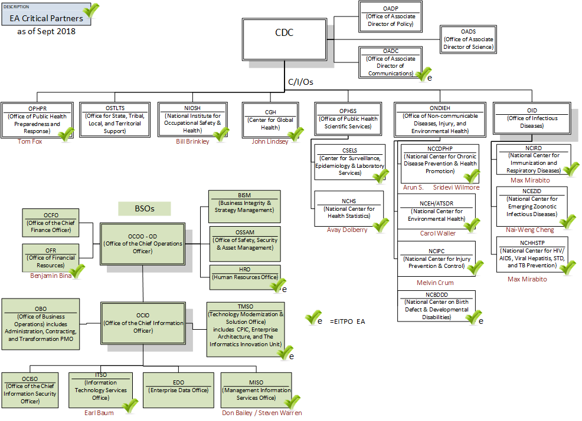
The EA CP Community
Notes:
Architecture = Design
Design = Strategy
Strategy = Planning
Enterprise perspective looking across project and organization silos eliminates rework
Agility through improved interoperability & reuse

Slide 9
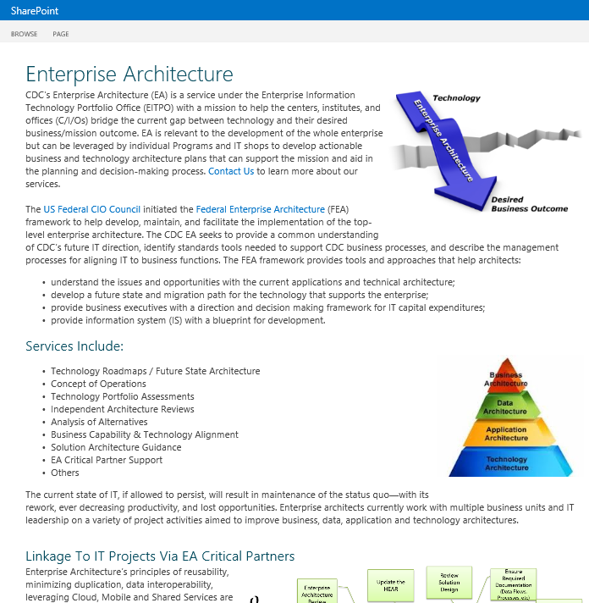
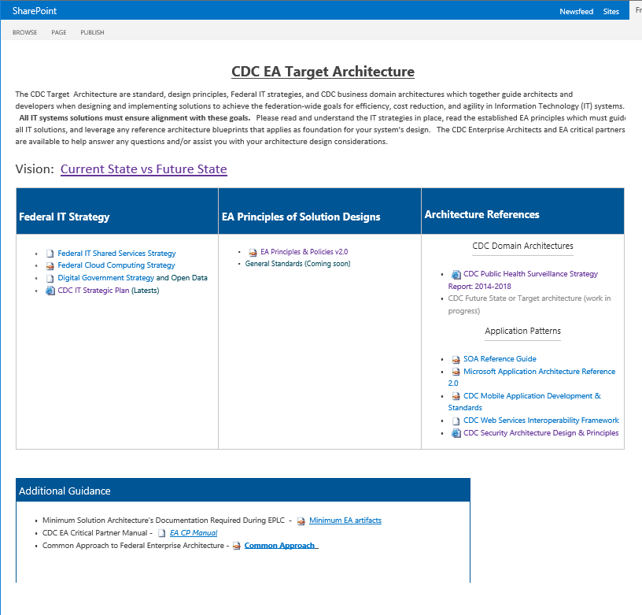
EA SharePoint Materials

Slide 10
Performing Project Reviews During the EPLC
Enterprise Architecture Critical Partners – A Primer
Notes:
Talking Points
Talk introduction about EPLC stages and what the role of the EA CP is in terms of ensuring business alignment, shared services, Open Data, Cloud, etc.
Brief about the role of the HEAR and why we (they) must begin using it during the EPLC gates
Next we will talk about each Stage Gate phase and their responsibilities

Slide 11
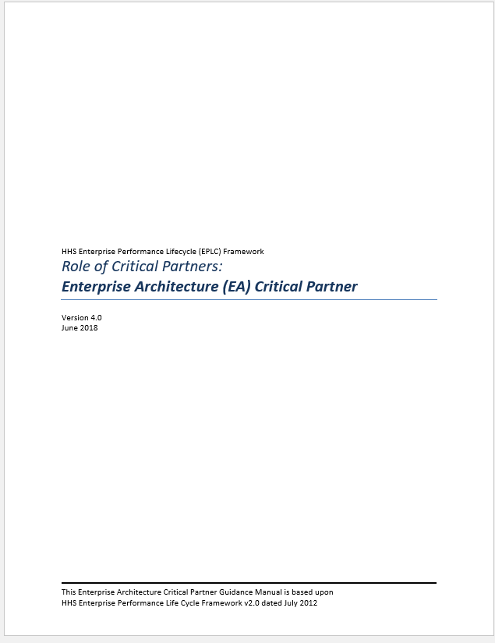
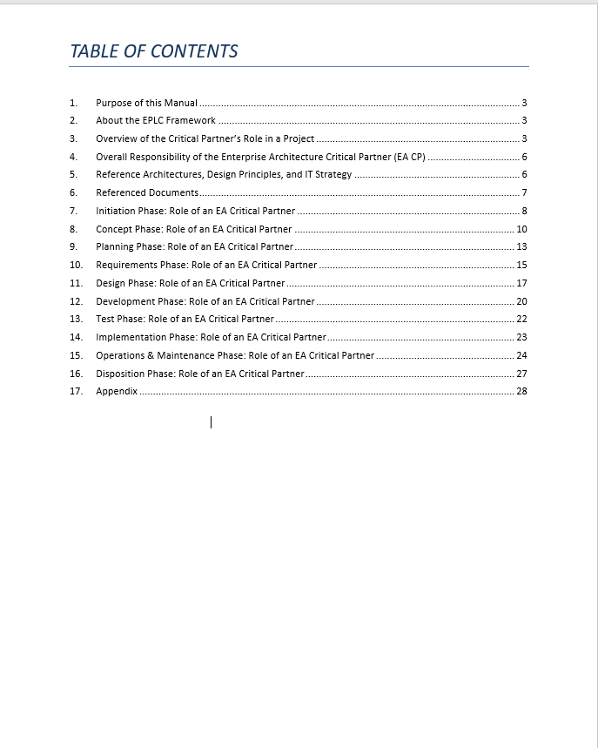

EA Critical Partner Manual - v4ed n

Slide 12
Ancillary Material
Enterprise Architecture Critical Partners – A Primer
Notes:
Talking Points
Talk introduction about EPLC stages and what the role of the EA CP is in terms of ensuring business alignment, shared services, Open Data, Cloud, etc.
Brief about the role of the HEAR and why we (they) must begin using it during the EPLC gates
Next we will talk about each Stage Gate phase and their responsibilities

Slide 13
The Business Need Statement
INITIATION PHASE
Example of vague & unclear statements…
…requires a standardized, core business management system to manage several key processes including Travel
Lack of scope clarity
Vague regarding underling business need
…establish one or more systems and processes
….currently have unique processes for managing day-to-day business activities and, therefore, have a wide variety of support systems. This results in some redundancies and inefficiencies, as well as performance, reliability and compliance issues.
The Business Need Document should abstain from technical solutions.
Several alternatives were discussed including .NET, SharePoint, HTML5/JS, LAMP and Cloud.
Touch point with relevant systems;
What do we mean by “touch points”? Which systems?

Slide 14
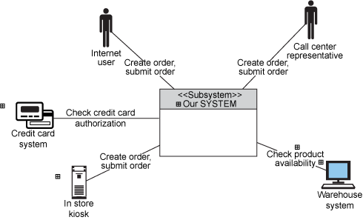
Concept of Operations – Example
Home shopping system context diagram
INITIATION PHASE
An EPLC deliverable/diagram focused on business operations, end-users, and information needs.
Graphical way for achieving consensus on proposed operational changes.
A collaborative approach to uncovering the underlying real needs & jointly thinking through the concepts needed to realize the operations of the desired future state.
An excellent way to consider partitioning scope into individual rollouts, releases, and/or sprints
Notes:
The customer wants to start a home shopping capability, with the ability to offer every single service in several ways: telephone call center, Internet, or in-store kiosk.
The company environment consists of a main office, and a warehouse at a separate location. The call center is outsourced.

Slide 15
Concept of Operations – Example
Home shopping system context diagram
Identify existing reusable services to minimize redundancies.
identify possible Shared Services
Identify system integration’s needs (existing interfaces, APIs, etc)
Begin to identify data implications (i.e, domain vocabulary, data entities)
identify associated Reference Architectures
The EA CP must perform an “Architecture Review” leveraging the ConOps to begin identifying inherited architecture requirements (i.e, existing common services, APIs, existing Data and IT strategy implications).
Notes:
The customer wants to start a home shopping capability, with the ability to offer every single service in several ways: telephone call center, Internet, or in-store kiosk.
The company environment consists of a main office, and a warehouse at a separate location. The call center is outsourced.

Slide 16
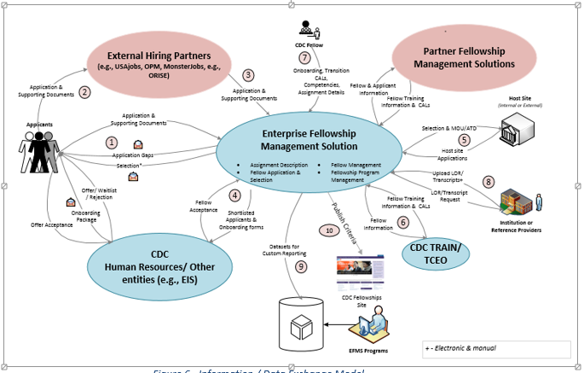
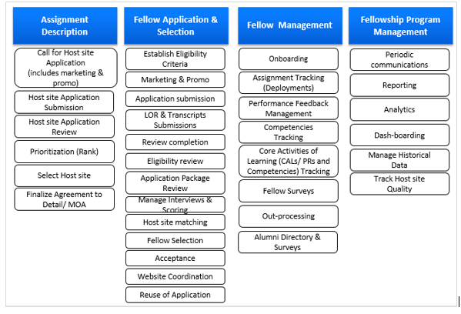
Concept of Operations – Example
CONCEPT PHASE
Notes:
[TALK ABOUT HOW THIS MA BE USEFUL TO CRITICAL PARTNERS]

Slide 17
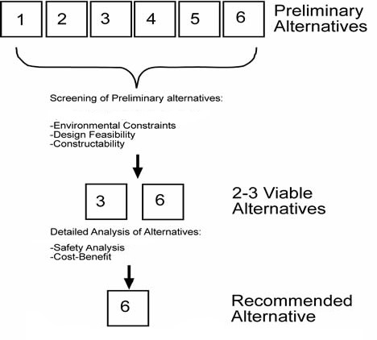
The Concept Phase
Concept of Operations diagram
The Business Case is being produced and the Analysis of Alternatives (AoA) must rconsider the requirements identified in the Concept of Operations and any existing architecture strategy requirements.
CONCEPT PHASE
The EA CP must influence the AoA early to ensure any architecture and IT strategy requirements are accounted in the analysis (i.e., existing services, APIs, Cloud strategy, IT ecosystem, etc).
Business Case – Analysis of Alternatives( AoA)

Slide 18
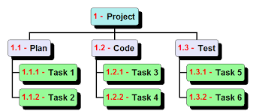
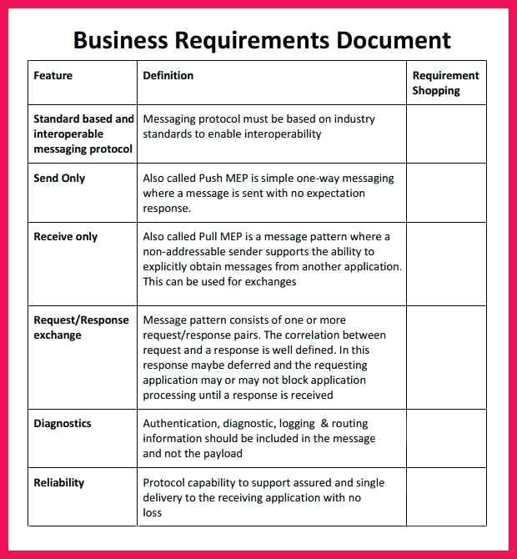
The Requirements Phase
Concept of Operations diagram
REQUIREMENTS PHASE
The ConOps aids the Project Manager to identify relevant project activities and where collection of detailed requirements is needed.
Should refine the ConOps if needed.
The EA CP verifies that requirements accounted for the ConOps, any architecture and IT strategy.
Detailed business requirements are now collected based on the operations identified in the ConOps and by further interviewing customers / stakeholders as needed.
Notes:
The customer wants to start a home shopping capability, with the ability to offer every single service in several ways: telephone call center, Internet, or in-store kiosk.
The company environment consists of a main office, and a warehouse at a separate location. The call center is outsourced.

Slide 19
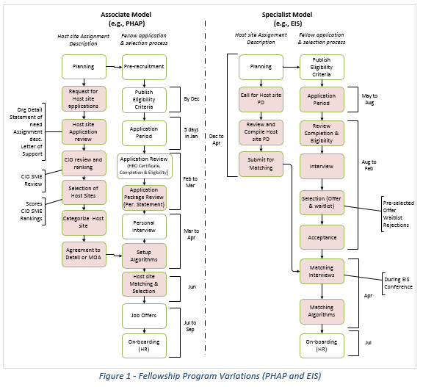
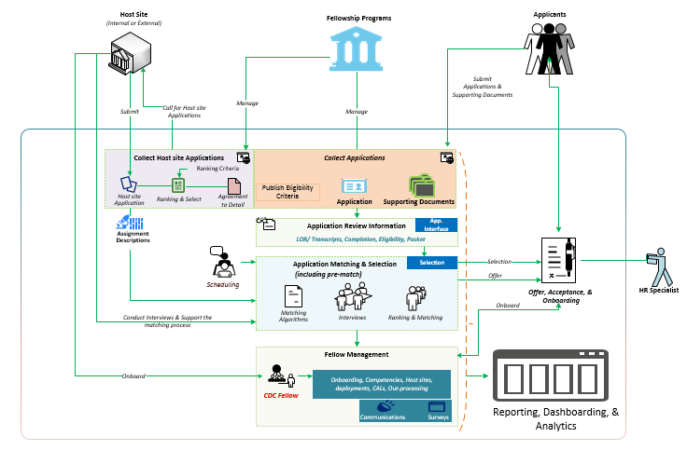
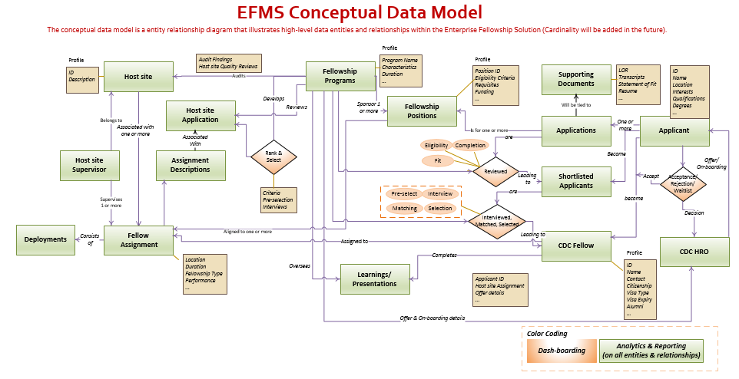
Example – Other Core Requirements Artifacts
High-level Business Process Flows illustrates sequence, activities, tasks, and dependencies
REQUIREMENTS PHASE
User scenarios captures the future operational use cases.
Functional Decomposition captures sub-capabilities
Conceptual/ Logical Data models captures the entities, relationships, and data flows.
The EA CP verifies that requirements accounted for the ConOps, any architecture and IT strategy.

Slide 20
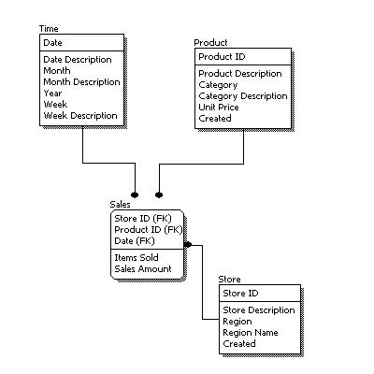
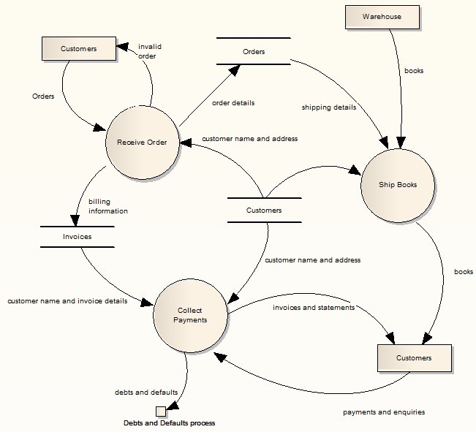
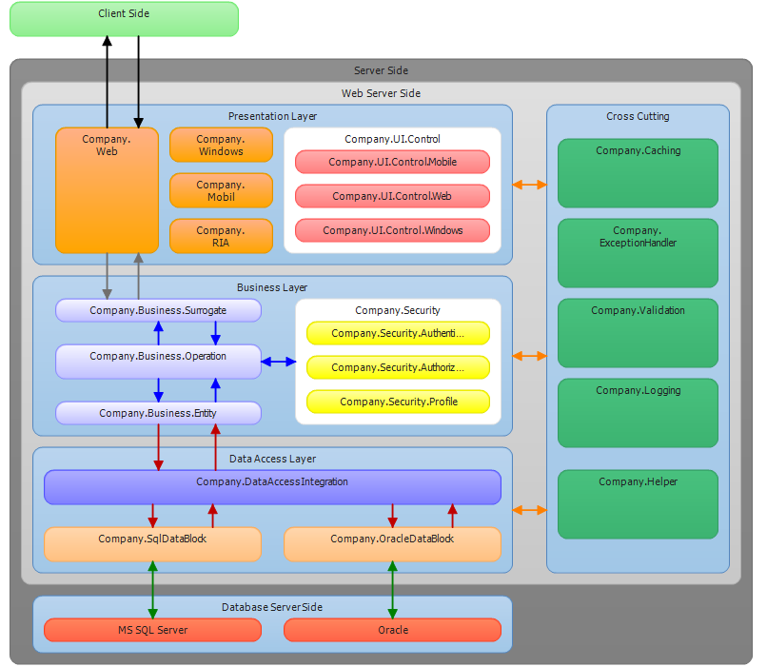
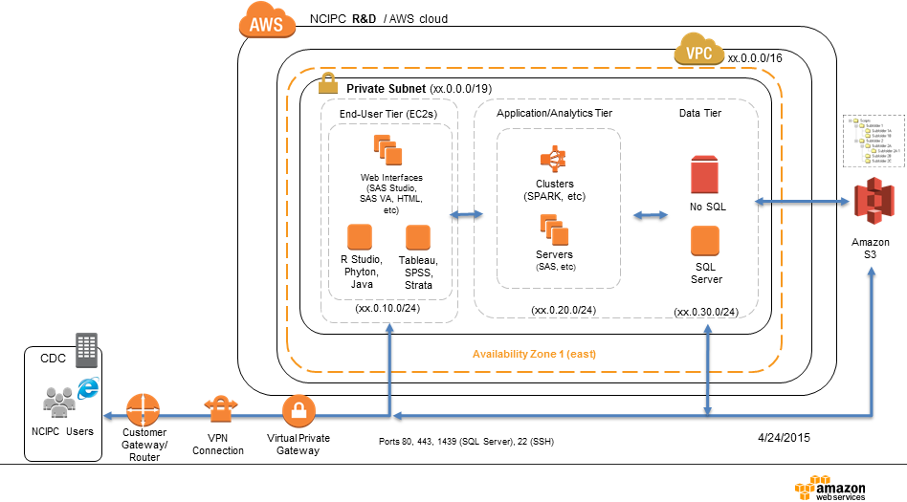
Design Phase
Example – Core Design Artifacts (i.e. Solution Architecture)
Data Flows & Information Exchanges (Data Architecture)
DESIGN PHASE
Component-based Architecture (i.e Logical Architecture)
System Architecture illustrates technology and network topology.
The EA CP verifies that solution designs align with identified architecture needs and IT strategy.

Slide 21
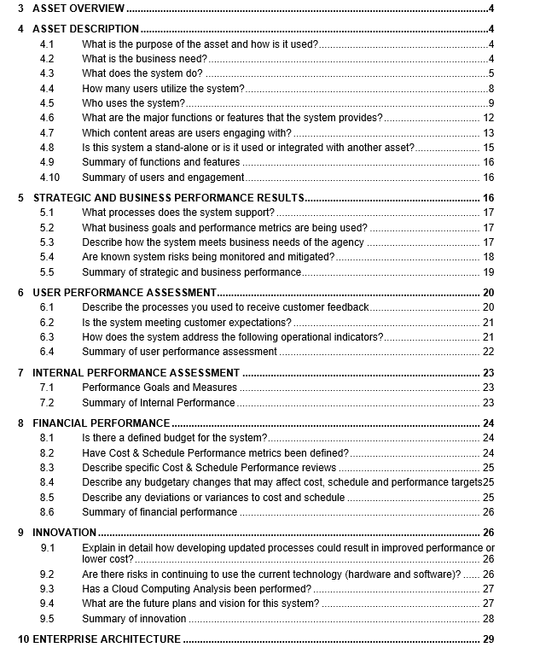
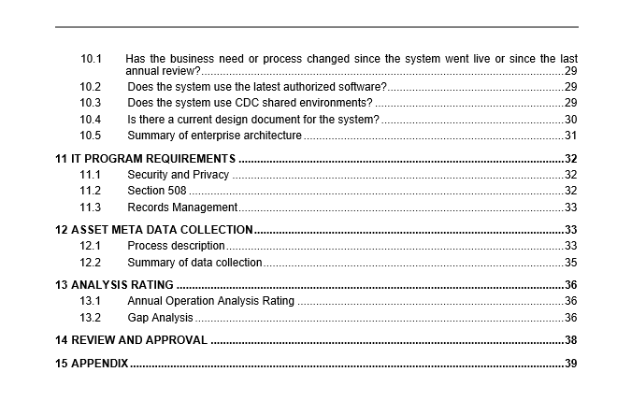
Example Operational Analysis
Operations and Maintenance
Hits all required dimensions and then some
Appropriate rigor for this organizations #1 IT priority
Used to inform on strategy and direction for this asset
O&M PHASE
The EA CP ensures that any identified changes account/align with the IT strategy.

Slide 22

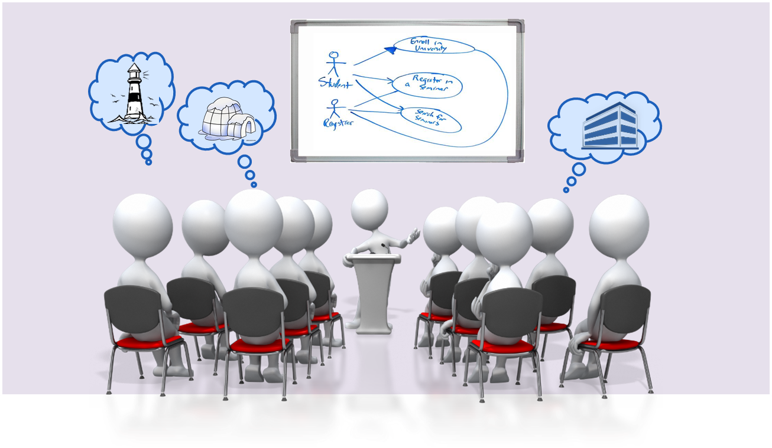
ConOps – Thank You !
Q&A
Questions? Contacts:
Enterprise Architecture team @ ea@cdc.gov .
Tim Mawhinney @(tvm9@cdc.gov or Ricky Freyre@ jrf1@cdc.gov
EITPO Online Job Aid doe ConOps:
https://esp.cdc.gov/sites/ocoo/EITPO/EPLC/SitePages/Concept%20of%20Operations.aspx

Slide 23
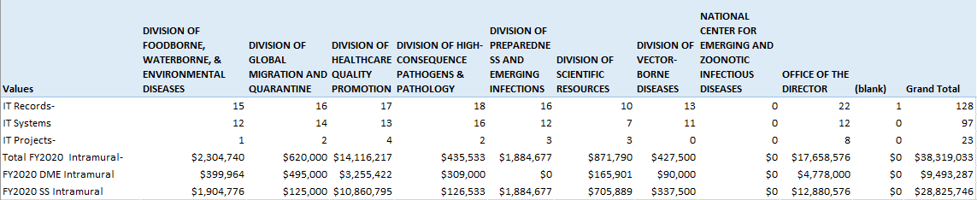
NCEZID IT Portfolio..

